Slide 1

SPORT PRODUCTS sales ANALYSIS

Slide 2
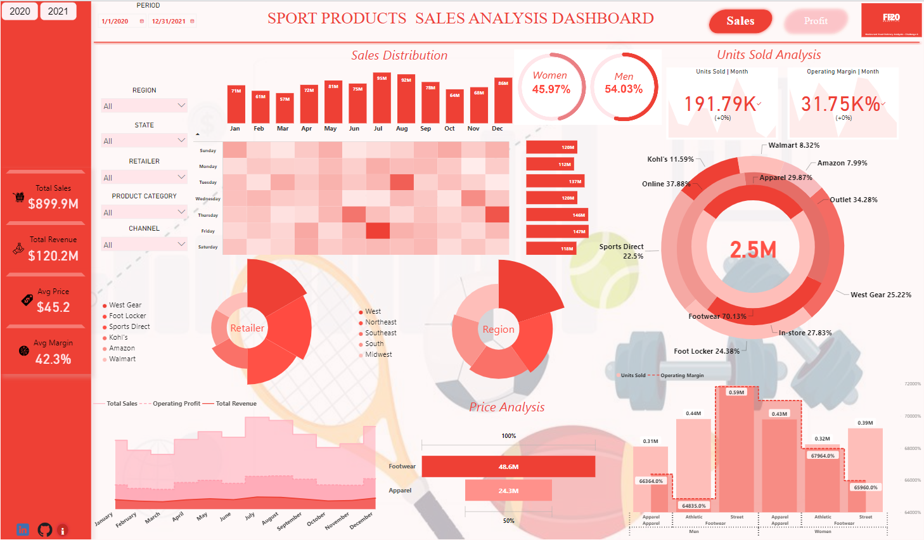

Slide 3
